Slide 1
IAG - IT Sovereignty
Collaboration Proposal
June 2026

Slide 2
Index
01
Context & Scope
02
Our Approach
03
Project Execution Methodology
04
Project Plan & Delivery Team
05
Economic Proposal

Slide 3
Context & Scope
01
Why IT sovereignty is now a board-level priority for IAG.

Slide 4


Why IT Sovereignty Has Become a Board Priority
The convergence of geopolitical, regulatory and operational factors has transformed IT Sovereignty from a technical consideration into a strategic governance priority.
1
Regulatory pressure
2
Geopolitical lansdcape
3
Reputation & Business resilience
New European and extraterritorial regulations are redefining how organisations govern data, cloud services, AI and critical ICT.
Increasing reliance on a small number of global technology providers creates new strategic dependencies beyond traditional cybersecurity risks.
Technology sovereignty is becoming a strategic capability that influences resilience, business continuity and long-term competitiveness.
US extraterritorial law
CLOUD Act · FISA 702
EU AI Act
High-risk AI · in force
Concentration on non-EU hyperscalers
Regulatory exposure
Extraterritorial jurisdiction
Vendor lock-in
GDPR / UK GDPR
Data protection & transfers
DORA
Operational resilience
Supply chain dependency
Loss of operational control
Cross-border operations
Reduced negotiation leverage
NIS2
Cyber resilience · air transport
EUCS & SEAL
EU cloud certification & sovereignty
Operational resilience
Reputational risk
IT Sovereignty is no longer only about compliance. It is about maintaining control over
critical digital capabilities while reducing strategic dependency and operational exposure.

Slide 5
How IAG’s Concerns Shape the Assessment
During the initial discussions, IAG consistently raised a number of business questions regarding technology control, dependency and resilience. These questions define the scope of the assessment.
Where is our critical information and who ultimately controls it?
Data location
Third-party access
CLOUD Act implications
How dependent are we on external technology providers?
Microsoft, Google, Amazon, Adobe, CrowdStrike
US technology providers
Vendor concentration
How does our international footprint affect sovereignty?
EU / UK / international operations
Cross-border services
Jurisdictional complexity
Are we assessing more than technology?
Contracts
Jurisdiction
Operations
Security
Business continuity
Where should IAG focus first?
Critical dependencies
Highest exposure
Prioritization
These questions cannot be answered independently.
They require a structured assessment that combines technology, legal, operational and governance perspectives.

Slide 6
Understanding dependencies, prioritizing risks and establishing a sustainable sovereignty governance model.
From Maturity Assessment to Sovereignty Capability
Sovereignty is not a one-off assessment. It is an ongoing management capability.
ASSESS
TAKE ACTION
GOVERN
Establish a clear sovereignty baseline across the Group by analyzing the most relevant applications, suppliers, contracts, cloud platforms and AI solutions
Convert findings into business decisions by identifying the most significant sovereignty exposures, concentration risks and remediation priorities
Embed sovereignty into day-to-day decision making through governance, controls and continuous monitoring
ACTIVITIES:
Critical applications inventory
Strategic supplier assessment
Prioritized contract review
Data & AI classification
SEAL-based sovereignty scoring
ACTIVITIES:
Dependency heatmap
Risk prioritization
Quick wins identification
Investment priorities
Board recommendations
CAPABILITIES:
Sovereignty Committee
Sovereignty Gate
Sovereignty Radar
IT Independence KPIs
Standards & Portability Catalogue
OUTCOME
OUTCOME
OUTCOME
Sovereignty Baseline
Board Roadmap
Permanent Sovereignty Capability
*The current scope includes the establishment of a Sovereignty Baseline within a 3-month period for identified Mission-Critical Systems of each Operational Company.

Slide 7
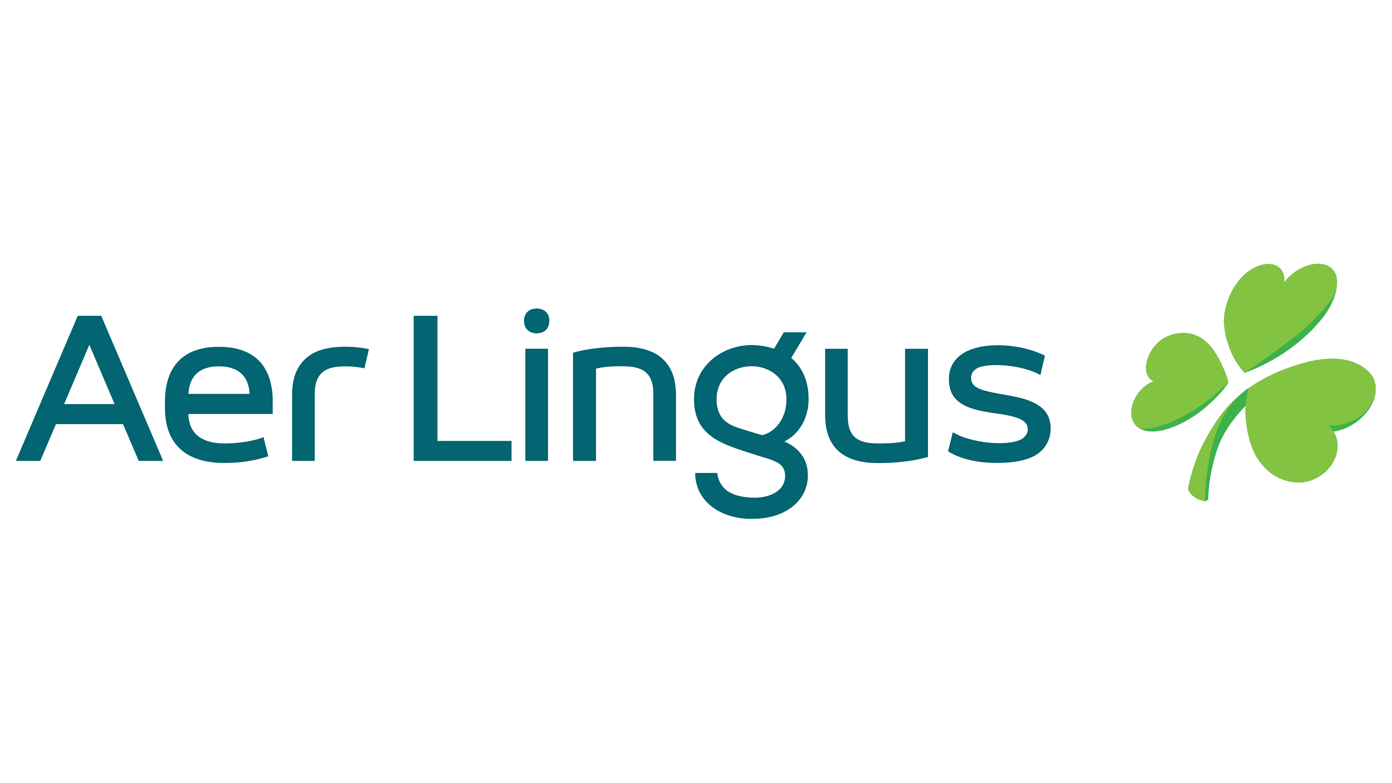









Scope: 10 Operating Companies, Prioritized by Criticality
Covering 100% of ICFR and mission-critical applications through an application-level sovereignty classification, with detailed deep dives focused on the highest-exposure applications.
Operating Companies & Application Volumes
Assessment Perimeter
Supplier
The assessment will cover the most relevant systems of each OpCo in terms of business criticality:
provided by
OpCo
belongs to
Applications
subject to
Relevant Contracts
10 Operating Companies (OpCos)
deployed at
Platform
Applications are the primary unit of sovereignty assessment, as they concentrate business processes, data, technology dependencies and supplier relationships.
140 ICFR/Mission-Critical Systems
Assessment coverage
All ICFR and mission-critical applications are assessed at application level to establish a Group-wide sovereignty classification.
This classification covers each application’s business criticality, data sensitivity, supplier dependency, cloud/platform footprint, AI usage and exit complexity.
Applications are then grouped into sovereignty risk clusters. Those with the highest exposure are selected for a detailed deep dive, where NTT DATA’s IT Sovereignty Assessment Model, aligned with the EU Sovereignty Framework, is applied across the five assessment domains.
ICFR
Both
Mission
Critical
74
17
49
Total ICFR: 91 · Total Mission Critical: 66 · Total unique apps: 140

Slide 8
Our Approach
02
A structured, evidence-based model build on a European Commission Sovereignty Framework.

Slide 9
A common model to assess digital sovereignty based on Commission initiatives such as IGREF’s Trusted Cloud Referential v2, Gaia-X policy rules and architecture, and the European Cybersecurity Certification Framework.
European Commission Sovereignty Framework
  The Sovereignty Objectives define the key dimensions that determine digital sovereignty. Together they cover legal exposure, data and AI control, operational resilience, supply chain dependencies, technology independence and security governance.
  The SEAL model defines the level of sovereignty assurance achieved for each objective. It measures the degree of control retained by the organization, ranging from complete dependency on non-EU actors (SEAL-0) to full digital sovereignty under EU control (SEAL-4).
Sovereignty
Score
SOV-1
Strategic
Measures how strongly critical services are anchored within the European legal, governance and industrial ecosystem.
15%
SEAL- 0
No Sovereignty
SOV-2
Legal & Jurisdictional
Evaluates the extent to which services are protected under European jurisdiction and insulated from external legal claims.
10%
Critical services operate under full non-EU control and jurisdiction.
Measures the protection, control and independence of data and AI services, including processing location and autonomy.
SEAL- 1
Jurisdictional Sovereignty
SOV-3
Data & AI
10%
EU law applies, but effective control remains with non-EU providers.
SOV-4
Operational
Evaluates which critical services can be operated and sustained without reliance on external providers, preserving continuity.
15%
SEAL- 2
Data Sovereignty
Data is protected under EU law, but significant non-EU dependencies remain.
SOV-5
Supply Chain
Assesses dependency on external providers by evaluating hardware and software provenance, transparency, auditability and resilience.
20%
SEAL- 3
Digital Resilience
Effective control is largely retained, with only limited non-EU dependencies.
Evaluates the openness, transparency and independence of the technology stack, reducing reliance on proprietary systems and vendor lock-in.
SOV-6
Technology
15%
SEAL- 4
Full Digital Sovereignty
Critical services operate under full EU control with no material non-EU dependencies.
Security & Compliance
Assesses the ability to maintain security, compliance and operational resilience under trusted governance, with independent oversight and auditability.
SOV-7
10%
Environmental
Sustainability
Evaluates the ability to sustain digital services over the long term by reducing resource dependency and improving environmental resilience.
SOV-8
5%
100%

Slide 10
The approach deliberately separates breadth from depth: combining a full critical application coverage classification with a targeted detailed assessment model only to the highest-exposure applications where sovereignty risk is material.
Two-Step Approach to Establish IAG’s Sovereignty Baseline
Sovereignty Screening & Clustering
IT Sovereignty Assessment Model
Owner-led declarative screening for the complete ICFR / mission-critical application inventory (+140 applications).
  Captures business context, data exposure, hosting, suppliers, AI exposure and exit/control signals.
  Applies a semi-quantitative classification based on exposure dimensions and agreed triggers that enables consistent prioritization without overengineering the initial classification.
  Avoids treating every critical application as equally risky.
  Produces a Prioritized Assessment Inventory with Tier 1~4 classification and rationale.
Focused deep-dive for Tier 1 applications where exposure is high or confidence is insufficient.
  Focuses expert effort where exposure may affect IAG control or resilience.
  Assesses control, dependency and resilience across five IT Sovereignty domains.
  Uses targeted evidence and interviews to prepare SEAL-aligned scoring.
  Consolidates results into a Sovereignty Maturity Report.
This approach enables a broad coverage first, and a subsequent detailed assessment only where the screening indicates material sovereignty exposure.

Slide 11


A structured, declarative and owner-led screening intake to capture the minimum information needed for a consistent application-level triage by sovereignty exposure to confirm which Tier 1 applications move to the following deep-dive assessment.
Sovereignty Screening & Clustering
Information captured from Application Owners
Classification Tiers
App & Business Context
OpCo, owner, business process, mission-critical / ICFR flag, disruption impact, etc.
Data Exposure
Data classification, personal / customer / employee / financial / regulated data, etc.
TIER 1
Deep-dive
High exposure or insufficient confidence requiring detailed assessment.
Selected for full
IT Sovereignty Assessment Model
TIER 2
Mitigate
Material exposure requiring action planning and targeted validation.
Included in
mitigation backlog
Hosting & Platforms
AI / GenAI usage, IAG data processed, retention, training, embedded AI in SaaS.
Supplier & Contract
Primary supplier, subcontractors, contract owner, key sovereignty clauses, etc.
TIER 3
Monitor
Relevant dependency but no material red flags based on screening.
To be tracked and refreshed periodically
AI Exposure
AI / GenAI usage, IAG data processed, retention, training, embedded AI in SaaS.
Control & Exit
Supplier access, key ownership, logs, portability, fallback option, lock-in, etc.
TIER 4
Controlled
Dependencies are known, limited and managed.
No immediate
action required

Slide 12
NTT DATA’s IT Sovereignty Assessment Model (aligned with the Commission’s Sovereignty Framework and SEAL assurance model) is used to evaluate an organization's level of control, dependency and resilience across 5 domains that together provide a complete view of sovereignty posture:
IT Sovereignty Assessment Model
1
2
3
4
5
DATA
INFRASTRUCTURE
OPERATIONS & TECHNOLOGY
SECURITY & COMPLIANCE
STRATEGIC & ENVIRONMENTAL
Covers sovereign control over data across its lifecycle, including where it is stored, accessed, used, protected and legally exposed.
Do we control our data
and AI assets?
Addresses how critical infrastructure is hosted, operated and recovered under acceptable jurisdictional, resilience and dependency conditions.
Do we control where and how services operate?
Focuses on the ability to operate, understand, evolve and transition technology without excessive reliance on non-sovereign platforms or ecosystems.
Can we operate, evolve and migrate independently?
Safeguards governed, auditable and resilient security, assurance and response capabilities under normal and disrupted conditions.
Can we protect and evidence control?
Examines long-term sovereign viability through durable governance, continuity, local value creation and responsible resource use.
Is the model sustainable and resilient on the long-term?
SOV-2
Legal & Jurisdictional
SOV-2
Legal & Jurisdictional
SOV-2
Legal & Jurisdictional
SOV-7
Security & Compliance
SOV-1
Strategic
SOV-3
Data & AI
SOV-4
Operational
SOV-4
Operational
SOV-8
Environmental
Sustainability
  Sovereignty Objectives
  covered by each domain
SOV-7
Security & Compliance
SOV-7
Security & Compliance
SOV-5
Supply Chain
SOV-6
Technology

Slide 13
Each domain is broken down into assessment dimensions and key criteria. The DATA domain evolves into Data & AI Sovereignty, spanning data, model and governance sovereignty.
IT Sovereignty Assessment Model - Dimension Details
1
DATA & AI
DIMENSION
DESCRIPTION
KEY ASSESSMENT CRITERIA
Production data, logs, backups, replicas and caches are mapped and restricted to approved jurisdictions, with controlled cross-border transfers and verifiable end-of-life destruction.
Cross-border data flows, APIs and SaaS integrations are identified, justified, legally assessed and protected through appropriate safeguards.
Provider, support and subcontractor access to sensitive data is least-privilege, time-bound, monitored, audited and revocable.
Encryption keys are generated, stored, rotated and revoked under customer-controlled key management, preventing unilateral provider decryption.
Classification by sensitivity, criticality and regulatory status drives enforceable handling, retention, DLP, access and protection.
Foundation models are inventoried with documented hosting; open-weight options, portability and single-provider dependency are assessed.
EU AI Act and ISO/IEC 42001 obligations, AI risk classification, model lineage, prompt/output ownership, human oversight and audit trails are governed.
Data- and AI-specific legal exposure, extraterritorial requests and foreign-access risks are mitigated through contractual, technical and operational controls.
Residency, Transfer & Lifecycle
Assesses how production data, metadata, logs, backups, replicas, caches and deletion processes are governed across the full data lifecycle, with emphasis on approved residency, controlled transfers and verifiable end-of-life destruction.
Data Access
Evaluates how provider, support and subcontractor access to organizational and customer data is restricted, monitored, audited and aligned to least-privilege and jurisdictional requirements.
Encryption & Key Ownership
Examines whether encryption keys protecting customer data and backups remain under customer-controlled custody across generation, storage, use, rotation, recovery and revocation, preventing unilateral decryption by the service provider.
Data Classification
Reviews how data is classified by sensitivity, criticality and regulatory status, and how handling, access, storage and protection rules are enforced across each class.
AI Model Sovereignty
Assesses control over and dependency on AI/foundation models: inventory, hosting, open-weight options and portability.
Data & AI Usage (Governance)
Governs AI/LLM usage and compliance: EU AI Act and ISO/IEC 42001, model hosting and lineage, prevention of third-party training reuse, and contractual ownership of prompts and outputs.
Legal Exposure & Transfer Safeguards
Mitigates foreign-access, extraterritorial and transfer risks via contractual, technical and operational safeguards.

Slide 14
Each domain is broken down into assessment dimensions and key criteria to evaluate the organization’s control, dependency and resilience posture.
IT Sovereignty Assessment Model - Dimension Details
2
INFRASTRUCTURE
DIMENSION
DESCRIPTION
KEY ASSESSMENT CRITERIA
Location
Assesses where core infrastructure, cloud regions, data centers and whether location choices support sovereignty.
Data centers, cloud regions are documented, controlled and located within acceptable jurisdictions.
Administrative rights, support paths, privileged operations and escalation routes are transparent.
Managed service providers, subcontractors and infrastructure operators are identified, contractually controlled, auditable and jurisdictionally assessed.
Lock-in and concentration risks are measured across critical platforms, vendors and hyperscalers, with credible fallback or portability options.
BCP/DR capabilities, geographic redundancy and RTO/RPO targets are defined, regularly tested and dependent only on approved locations and providers.
Infrastructure compliance evidence is current, scope-relevant and mapped to applicable obligations such as NIS2, DORA, ISO 27001, EUCS and sector-specific requirements.
Ownership & Operational Control
Evaluates who owns, administers, operates and supports the infrastructure layer, including managed service providers, subcontractors, privileged administration paths and the jurisdictions from which infrastructure control is exercised.
Dependency & Concentration Risk
Examines concentration, lock-in and fallback risk across hyperscalers, infrastructure vendors, regions, facilities and critical platform services, including the credibility of alternative hosting.
Resilience
Reviews continuity, disaster recovery, geographic redundancy and recovery objectives for the infrastructure layer, including whether resilience capabilities are defined, tested and anchored in approved locations and providers.
Regulatory Compliance
Assesses whether infrastructure controls, certifications and evidence align with relevant security, resilience and sector-specific regulatory obligations.

Slide 15
Each domain is broken down into assessment dimensions and key criteria to evaluate the organization’s control, dependency and resilience posture.
IT Sovereignty Assessment Model - Dimension Details
3
OPERATIONS & TECHNOLOGY
DIMENSION
DESCRIPTION
KEY ASSESSMENT CRITERIA
Architecture Independence
Assesses whether the technology architecture is open, transparent, auditable and based on documented standards, reducing dependency on proprietary interfaces and opaque design.
Critical services use documented APIs, open standards and transparent integration patterns that limit proprietary lock-in.
Teams in approved jurisdictions have the runbooks, documentation, skills, source access or know-how required to operate and evolve the solution.
Workloads can be migrated to credible alternatives with measurable cost, time and redesign constraints.
Hardware, firmware, embedded code, software origin, update channels and package integrity are traceable and governed.
Supplier and sub-supplier chains are visible, contractually auditable and supported by SBOMs, licensing evidence and update-governance records.
Reliance on non-EU compute, accelerators, software ecosystems, operational jurisdictions and IP control points is assessed and mitigated where material.
Operational Autonomy
Evaluates whether the technology can be operated, supported and evolved by EU/UK teams, with sufficient documentation, skills and know-how to sustain long-term autonomy.
Portability & Exit
Examines the practical ability to migrate workloads, configurations and operational processes to an alternative EU-controlled solution within acceptable cost, time and redesign effort.
Supply Chain
Reviews the provenance, governance and auditability of critical hardware, firmware, embedded code, software packaging, distribution, updates and sub-supplier dependencies.
Technology Stack Independence
Assesses dependency on critical compute, processors, accelerators, runtimes, managed services, software ecosystems and IP control points.
IP, Development & Technology Jurisdiction
Evaluates the jurisdiction governing intellectual property creation, registration, licensing, development, software distribution, update rights and technology restrictions such as export controls.

Slide 16
Each domain is broken down into assessment dimensions and key criteria to evaluate the organization’s control, dependency and resilience posture.
IT Sovereignty Assessment Model - Dimension Details
4
SECURITY & COMPLIANCE
DIMENSION
DESCRIPTION
KEY ASSESSMENT CRITERIA
Security Operations & Monitoring Control
Assesses whether SOC, MDR, SIEM, SOAR, detection and response operations are governed, monitored and recoverable under controlled operating conditions.
Clear decision rights, roles and escalation paths exist for security operations, access control, incident handling and evidence management.
Critical security capabilities can continue during provider disruption, restricted vendor support, service degradation or loss of normal operating channels.
Privileged, emergency and third-party access is least-privilege, segregated, monitored, time-bound, auditable and rapidly revocable.
Security data, forensic evidence, backups and keys are subject to defined residency, retention, access, integrity and chain-of-custody controls.
Certifications, audit reports and compliance evidence are current, scope-relevant and mapped to applicable EU/UK security, privacy and resilience obligations.
The organization can investigate, contain, patch, recover and transition operations without unacceptable dependency on a non-EU provider.
Identity & Privileged Access
Evaluates how human, service, emergency, remote administration and third-party privileged identities are governed across their lifecycle, with emphasis on segregation, assurance, monitored use, time-bound elevation and rapid revocation.
Security Data & Evidence
Examines how security logs, telemetry, forensic artefacts, backups and cryptographic keys are collected, protected, retained and accessed to support investigation, auditability and legal defensibility.
Certifications & Compliance
Reviews the independent assurance, certifications, regulatory alignment and contractual evidence demonstrating adherence to security, privacy, resilience and sector-specific obligations.
Incident Response & Secure Continuity
Evaluates the ability to investigate, contain, remediate and securely recover from security incidents while sustaining critical security and service operations during provider disruption, technology failure or exit scenarios.

Slide 17
Each domain is broken down into assessment dimensions and key criteria to evaluate the organization’s control, dependency and resilience posture.
IT Sovereignty Assessment Model - Dimension Details
5
STRATEGIC & ENVIRONMENTAL
DIMENSION
DESCRIPTION
KEY ASSESSMENT CRITERIA
Strategic Anchoring
Assesses whether decisive ownership, governance and change-of-control arrangements are anchored in EU/UK jurisdictions, and whether the service contributes to long-term sovereign capability, investment and continuity.
Decisive ownership, governance rights and change-of-control protections are transparent and anchored within acceptable jurisdictions.
The service demonstrates meaningful EU/UK value creation, capability-building and alignment with digital or industrial sovereignty initiatives.
Secure operations can be sustained if provider support is withdrawn, suspended or disrupted, supported by contingency, escrow or transition arrangements.
Energy performance and infrastructure efficiency are measured through PUE or equivalent metrics, with clear improvement targets.
Carbon emissions, water consumption and energy sourcing are disclosed through verifiable sustainability reporting.
Environmental, energy and resource dependencies are considered in long-term resilience, continuity and technology strategy.
Environmental Sustainability
Evaluates the long-term sustainability and environmental resilience of infrastructure, including energy efficiency, resource consumption, carbon and water transparency, and use of renewable or low-carbon energy.

Slide 18
Project Execution Methodology
03
A phased strategy to assess the current IT Sovereignty posture in IAG.

Slide 19



NTT DATA proposes a pragmatic, evidence-led and AI-assisted approach to help IAG understand where sovereignty exposure is material, what is already under control, and which actions should be prioritized to reduce risk without unnecessary disruption.
Keys to a Methodological Execution Strategy
EVIDENCE LED ASSESSMENT
STRUCTURED SOVEREIGNTY FRAMEWORK
ACTIONABLE DECISIONS
We assess sovereignty based on traceable evidence: contracts, supplier information, cloud regions, data flows, security controls, operational processes, architecture documentation and structured interviews.
We apply a SEAL-aligned assessment model across key sovereignty domains, using AI-assisted analysis to accelerate evidence review, identify patterns and compare exposure consistently across OpCos, applications, suppliers and contracts.
The diagnostic translates technical, legal and operational findings into prioritized gaps, must-change / can-stay decisions, quick wins and a roadmap direction for the next phase.
What does this approach enable?
Strategic focus
Informed decision-making
Common framework
Measurable evolution
Prioritization of the OpCos, applications, suppliers and contracts with the highest sovereignty exposure and criticality.
An objective, AI-accelerated evidence base to support Board, CIO/CISO, procurement, legal and OpCo decisions.
A shared language across business, technology, legal, and procurement to evaluate digital sovereignty.
A repeatable scorecard and heatmap to track sovereignty maturity, dependency reduction and remediation progress.

Slide 20
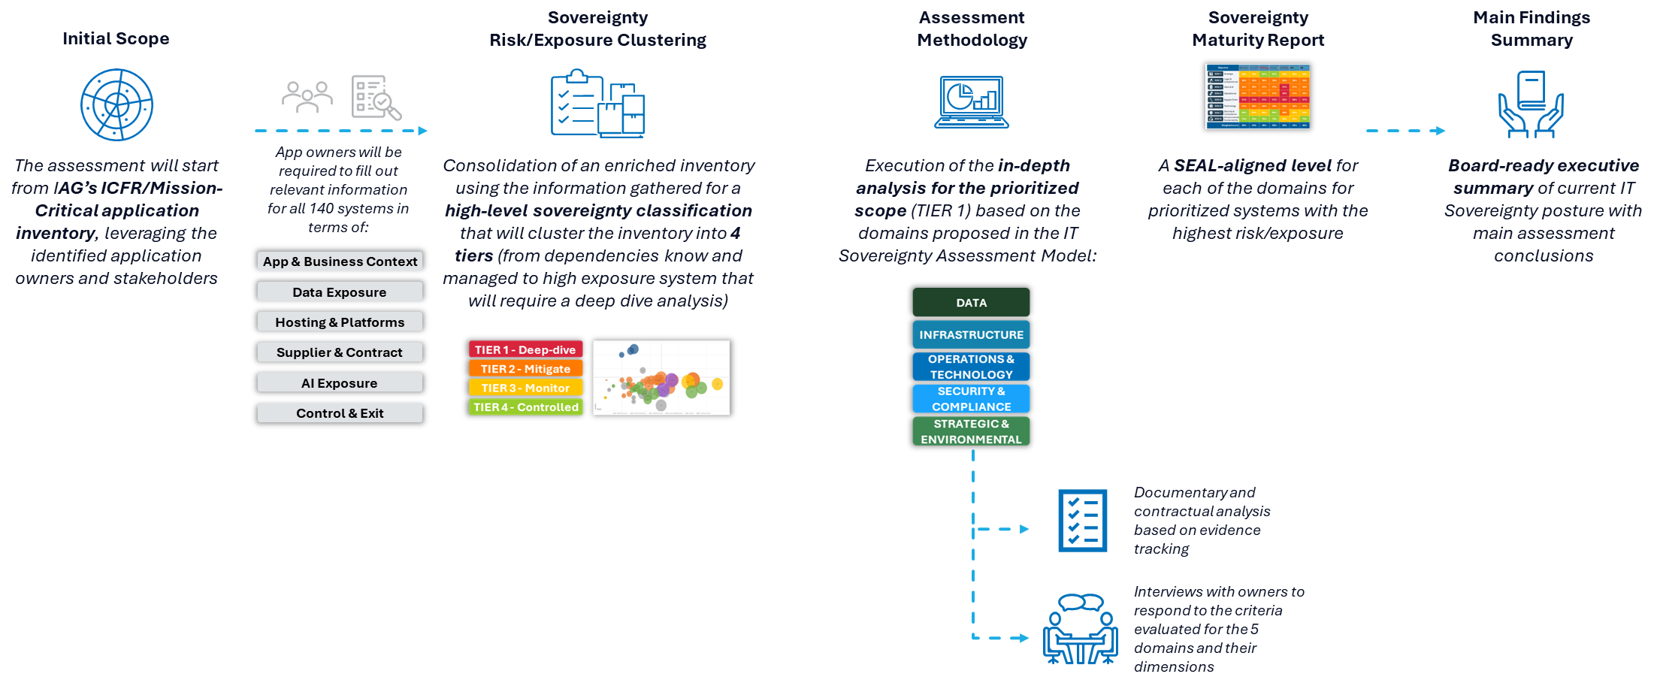
The methodology is designed to provide an evidence-based view of IAG’s current sovereignty posture, progressing from scope definition to baseline assessment and roadmap decisions in a structured 3-month plan.
A Phased Execution Methodology
5 weeks
7 weeks
6 weeks
P1 SYSTEMS SCOPE & RISK CLUSTERING
P2 INFORMATION & DOCUMENTATION DISCOVERY
P3 SOVEREIGNTY MATURITY REPORT GENERATION
Define the risk-based perimeter, prioritization logic and IAG-tailored sovereignty assessment model.
Collect and analyze evidence across systems, suppliers, contracts, platforms and data flows.
Consolidate validated outcomes into a sovereignty maturity report, executive findings and decision-ready conclusions.

Slide 21



Phase 1 - Systems Scope & Risk Clustering
A Phased Execution Methodology
Goal
Establish a shared, risk-informed foundation for the assessment, ensuring that effort is focused where sovereignty exposure could materially affect IAG’s ability to control, operate and evolve its critical technology landscape, focusing the analysis on the most relevant systems, suppliers and data domains.
Activities
Duration
5 weeks
IAG Implication
Medium
Scope definition and prioritization
  Identify business-critical systems on high-exposure areas for each Opco to be included in the assessment inventory.
  Match systems in the inventory with their owners, suppliers, contracts, data domains, tech platforms, etc.
  Rank and prioritize the inventory to select the scope for each project milestone with agreed criteria (business criticality, sovereignty exposure, regulatory sensitivity, operational dependency, supplier concentration, data sensitivity and assessment feasibility, etc.).
  Prioritize the assessment scope into waves or milestones, ensuring alignment with IAG’s delivery capacity and stakeholder availability.
Stakeholder alignment
  Identify all relevant key business, technology, security, procurement, legal, privacy, architecture and operational stakeholders required for the assessment.
  Agree roles and responsibilities across IAG Group, OpCos and NTT DATA.
  Establish the project governance model, cadence, escalation routes and decision-making forums.
  Align objectives, expectations and assessment boundaries, dependencies and identified risks & mitigations.
Assessment model tailoring and preparation
  Adapt the IT Sovereignty Assessment Model to IAG’s context, operating model and regulatory landscape.
  Define the information requests, interview guides and calendar, and concrete assessment questionnaires required for the analysis.
Accelerators & Mechanisms
Kick-off and scope narrowing sessions
Shared repository and necessary accesses requested
Dependency matrix and risk register
System Scope Prioritization Model
IT Sovereignty Assessment Model
Deliverables
D1.1. Scope, Dependency and Risk Matrix
D1.2. Stakeholder Engagement and Access Plan
D1.3. Prioritized Assessment Inventory
D1.4. Tailored IT Sovereignty Assessment Model
IAG Resources
Executive Sponsor / Project Lead
Enterprise Architects
System Owners
Cloud / Infra. Platform Owners
Cybersecurity / Data Protection
Legal & Regulatory
Procurement & Supplier Mngmt.
Service Mngmt. / IT Operations

Slide 22

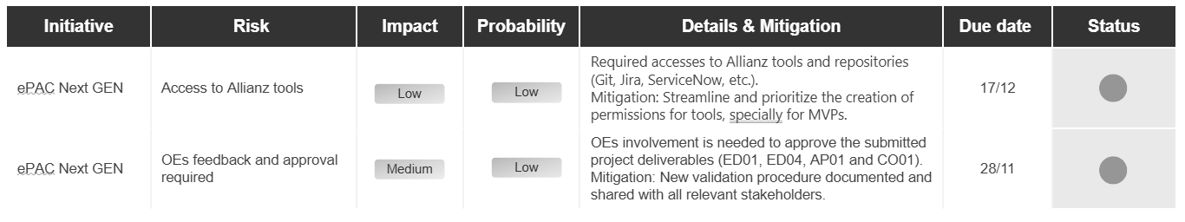
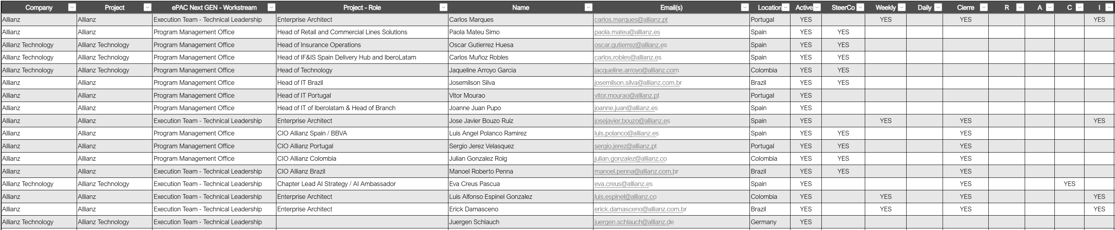
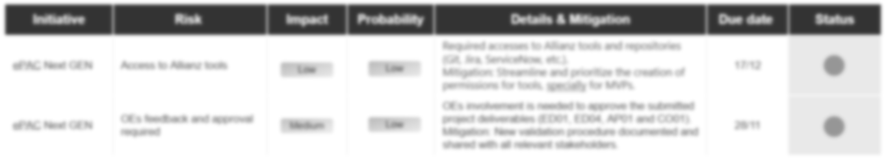
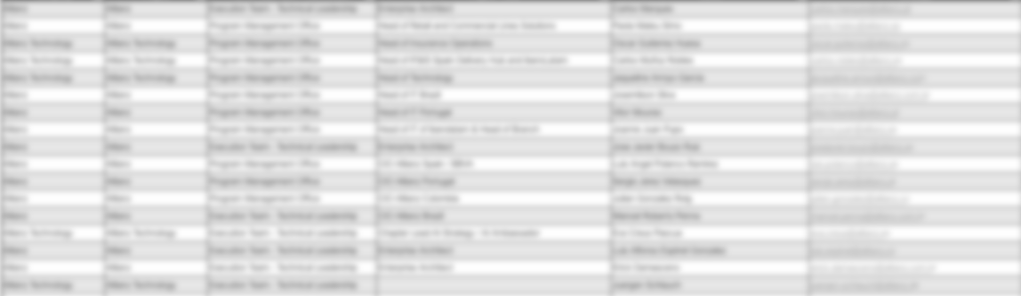
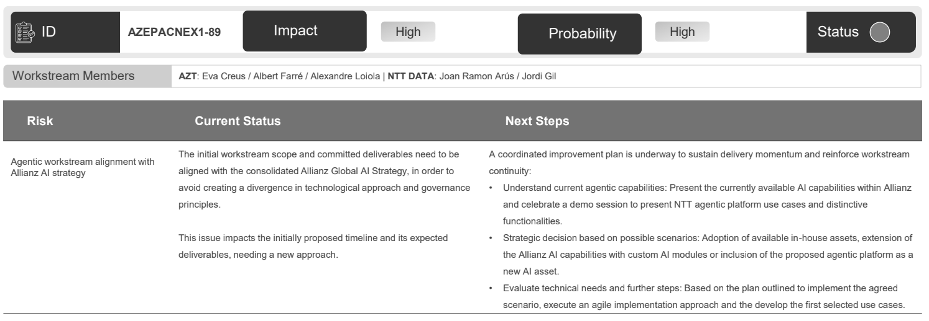
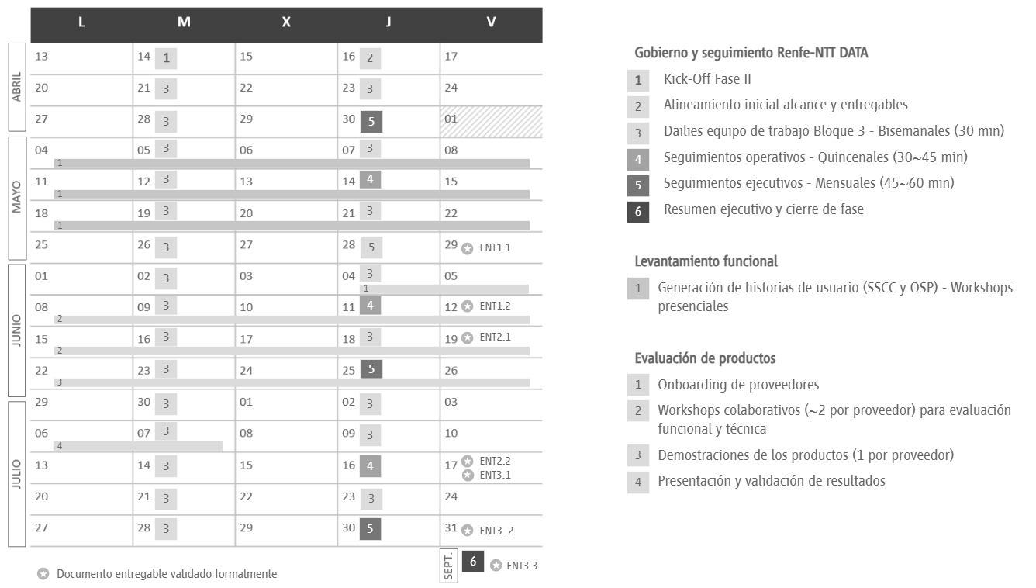


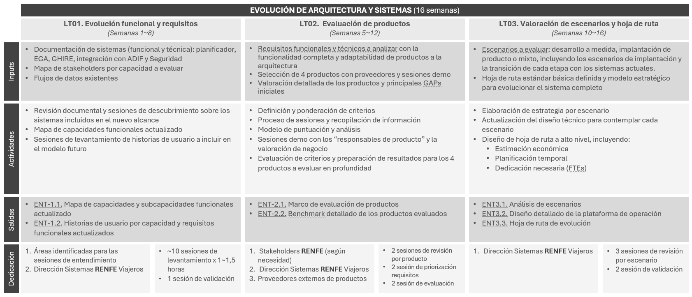
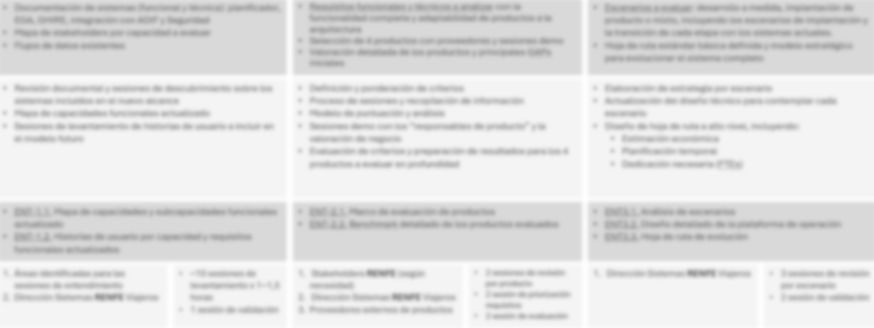
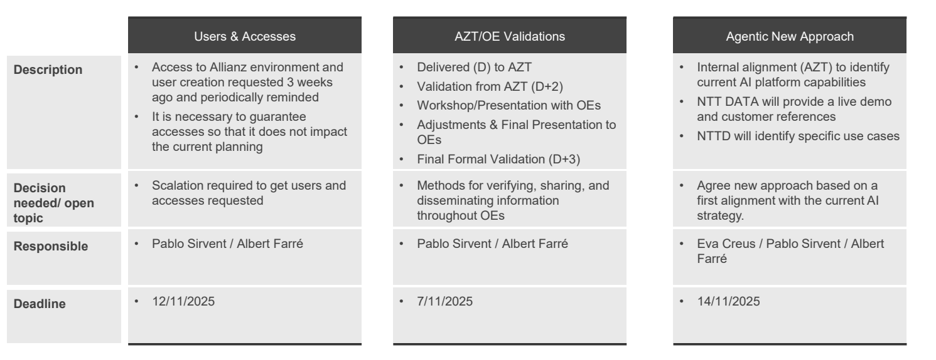
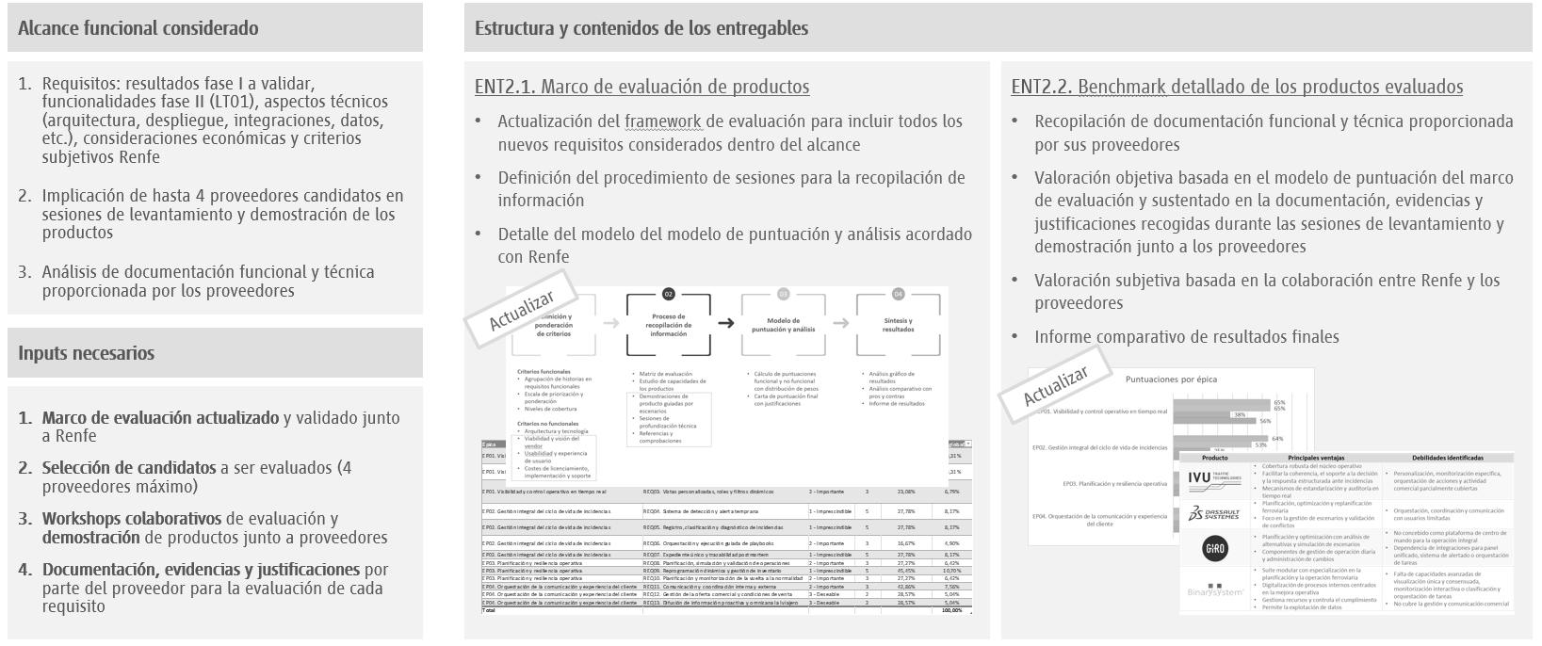


Phase 1 - Systems Scope & Risk Clustering
A Phased Execution Methodology
DELIVERABLES - ILLUSTRATIVE EXAMPLES
D1.1. Scope, Dependency and Risk Matrix
D1.2. Stakeholder Engagement and Access Plan
Definition of assessment scope, boundaries, dependencies, assumptions, exclusions and initial risks to be monitored during execution.
List of required stakeholders, interview schedule, governance forums, repository structure and access requirements.

Slide 23
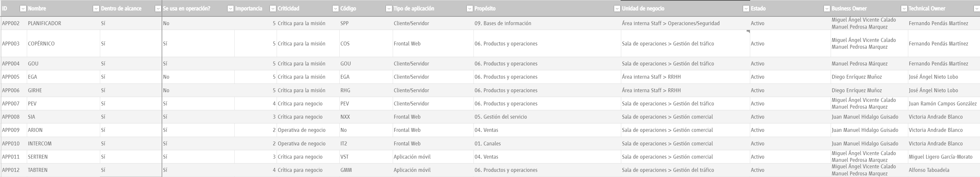
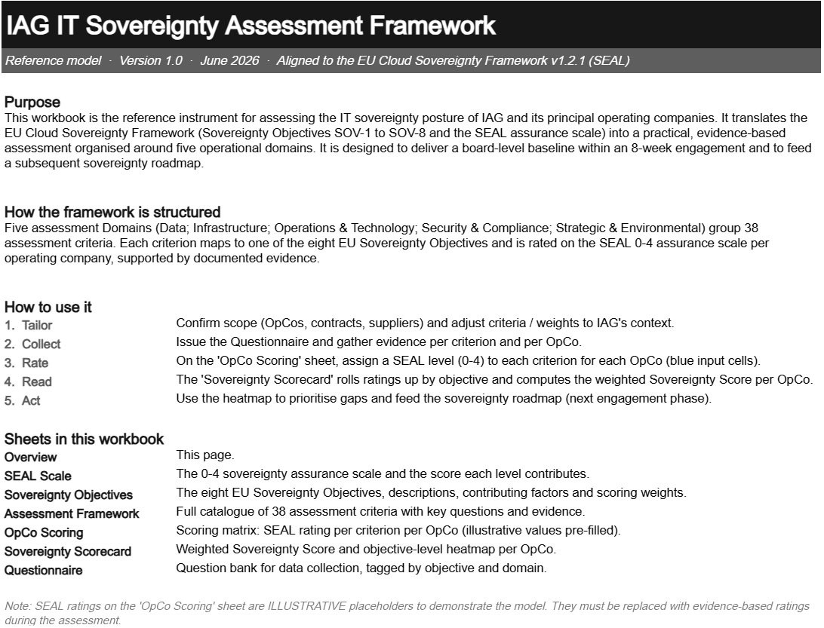
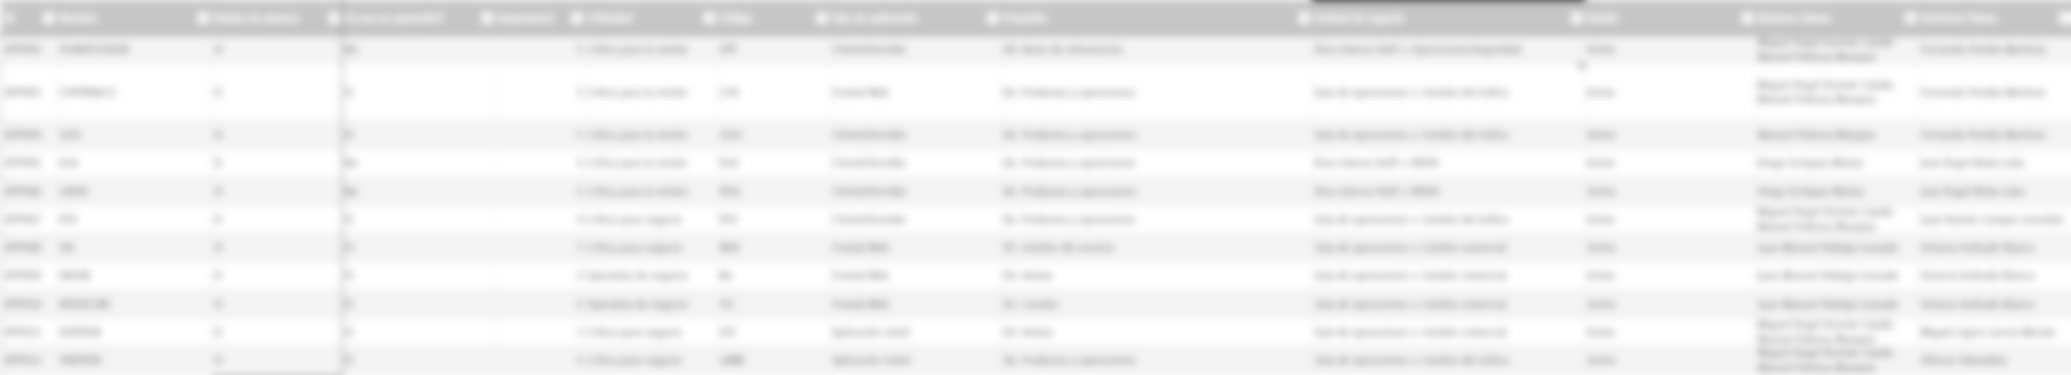
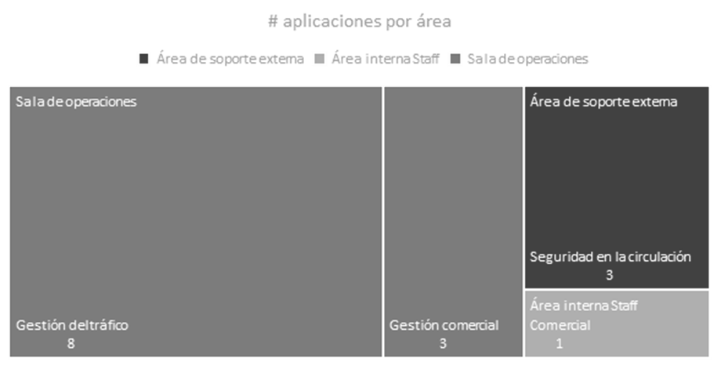
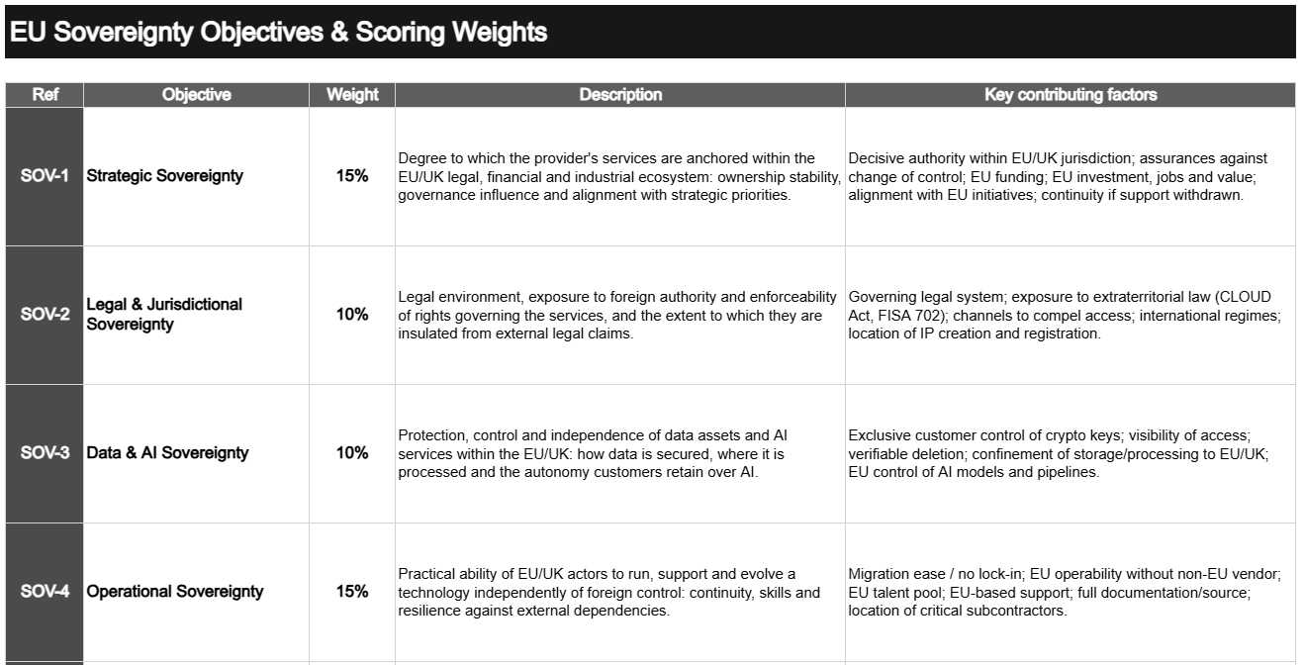
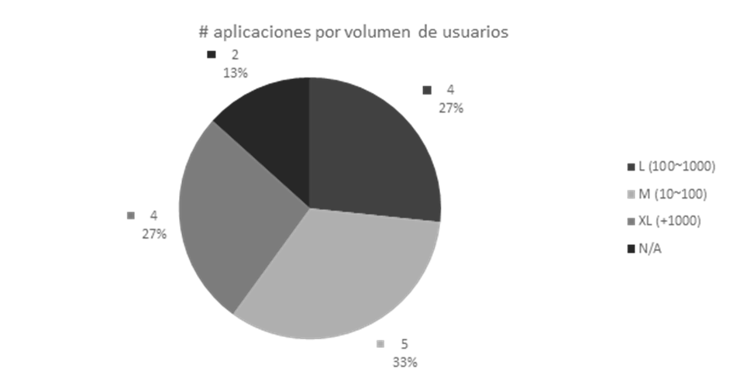
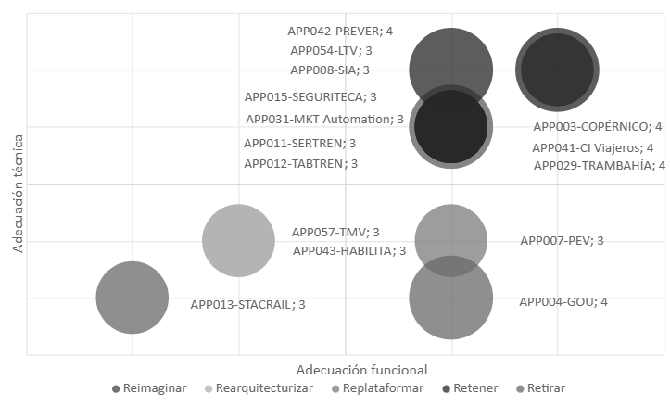
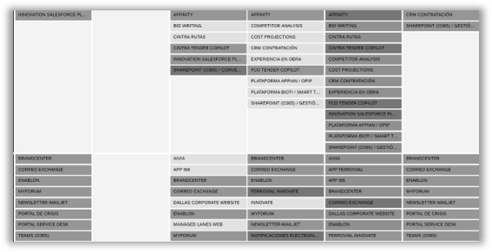
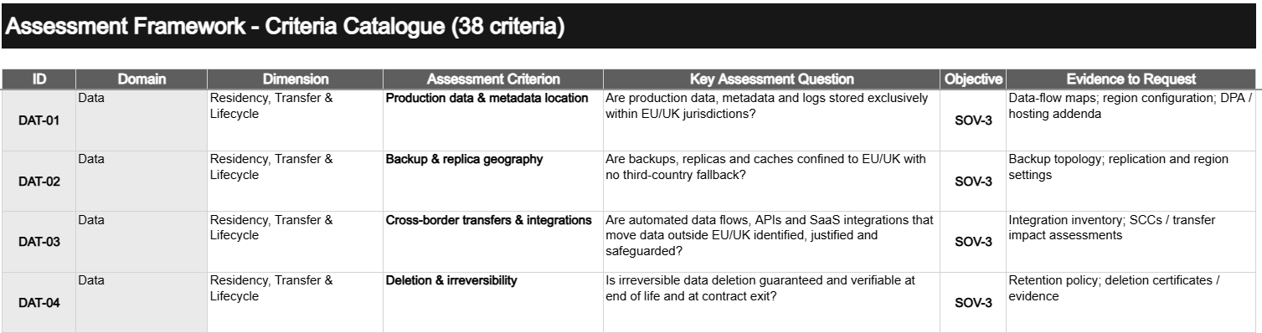
Phase 1 - Systems Scope & Risk Clustering
A Phased Execution Methodology
DELIVERABLES - ILLUSTRATIVE EXAMPLES
D1.3. Prioritized Assessment Inventory
D1.4. Tailored IT Sovereignty Assessment Model
Consolidated inventory of systems, suppliers, platforms and data domains selected for assessment, including clustering risk classification, prioritization criteria and rationale.
Adapted assessment framework, including domains, dimensions, criteria and structured questions for evaluation, scoring logic and evidence requirements for IAG to support consistent information gathering.

Slide 24
Phase 2 - Information & Documentation Discovery
A Phased Execution Methodology
Goal
Build an evidence-based understanding of IAG’s current sovereignty posture, revealing the extent to which critical technology services, data and supplier arrangements remain controllable, resilient and aligned with organizational sovereignty expectations.
Activities
Duration
7 weeks
IAG Implication
High
Evidence collection and document review
  Collect evidence from system owners, platform teams, supplier managers and control functions.
  Review architecture diagrams, data-flow maps, hosting configurations, cloud region settings, contracts, DPAs, SLAs, operational procedures, security controls and supplier documentation.
  Validate the completeness and quality of the evidence received.
  Track missing evidence, open questions and areas requiring clarification.
  Identify where evidence is system-specific, supplier-specific, platform-level or enterprise-level.
Stakeholder interviews and workshops
  Conduct interviews with business, technology, architecture, security, operations, legal, privacy and procurement stakeholders.
  Understand current operating models, supplier relationships, technical dependencies, governance processes and known constraints.
  Capture current control ownership, decision rights, operational responsibilities and escalation paths.
  Identify perceived risks, pain points, known gaps and existing mitigation initiatives.
  Validate evidence and clarify inconsistencies between documentation and actual operating practices.
Accelerators & Mechanisms
Evidence tracker and completeness dashboard
Structured interview guides
Supplier and system assessment templates
Periodic assessment working sessions
Deliverables
D2.1. Evidence Collection Tracker
D2.2. Completed Assessment Questionnaires
IAG Resources
Executive Sponsor / Project Lead
Enterprise Architects
System Owners
Cloud / Infra. Platform Owners
Cybersecurity / Data Protection
Legal & Regulatory
Procurement & Supplier Mngmt.
Service Mngmt. / IT Operations

Slide 25
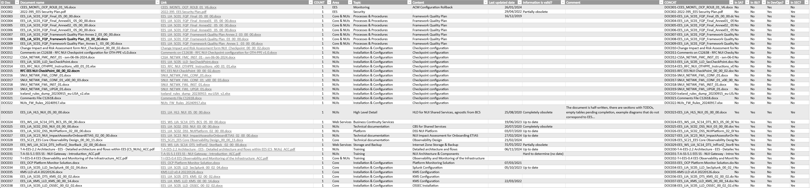
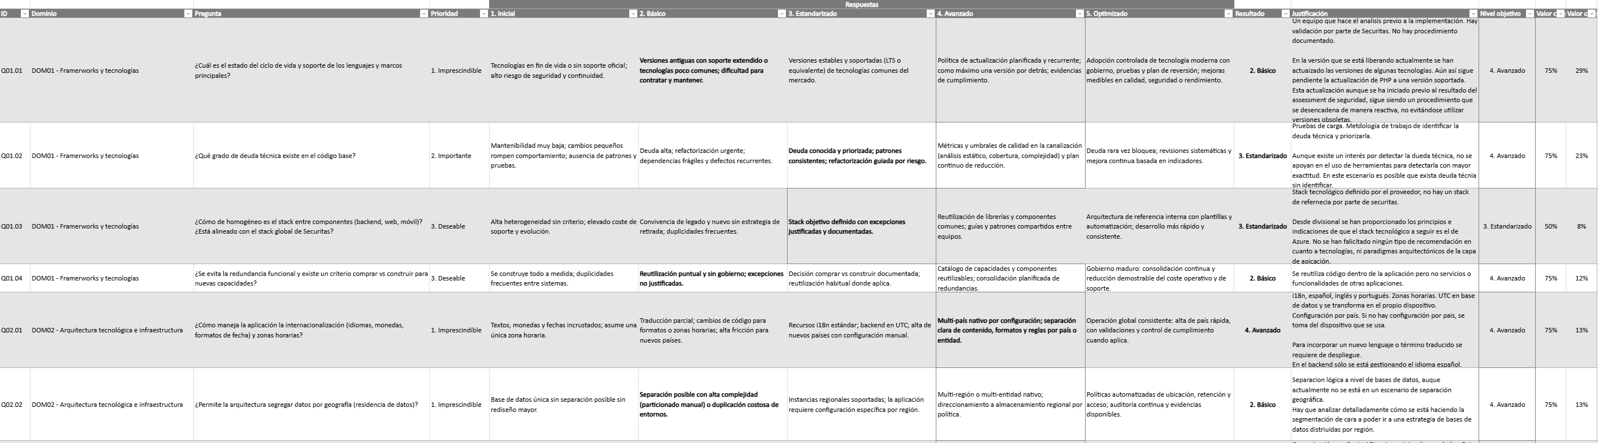
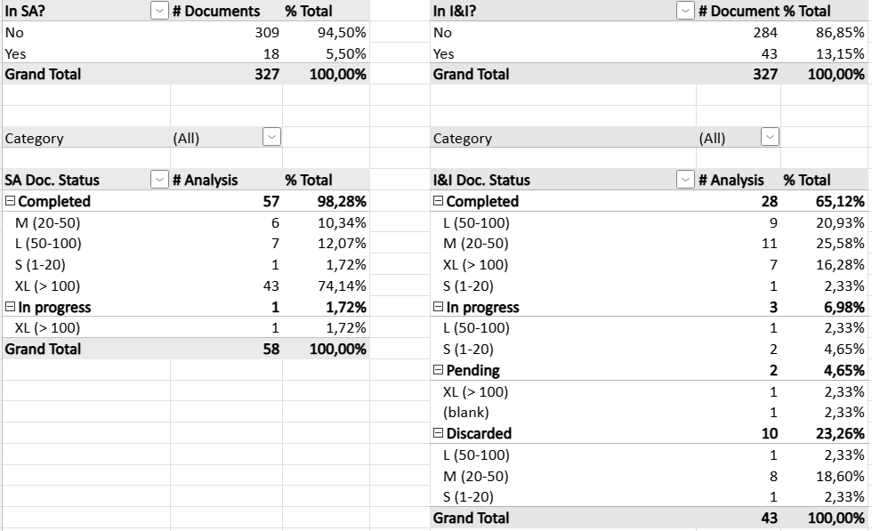
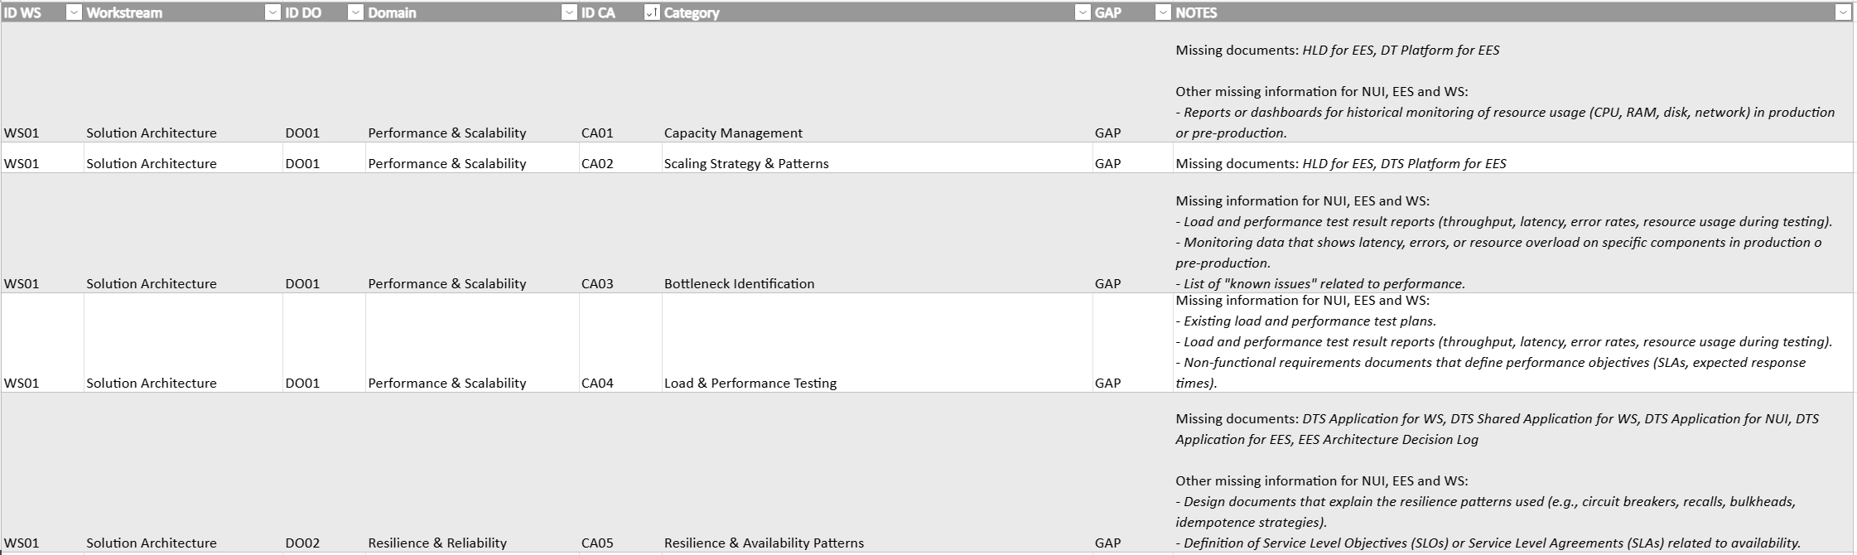
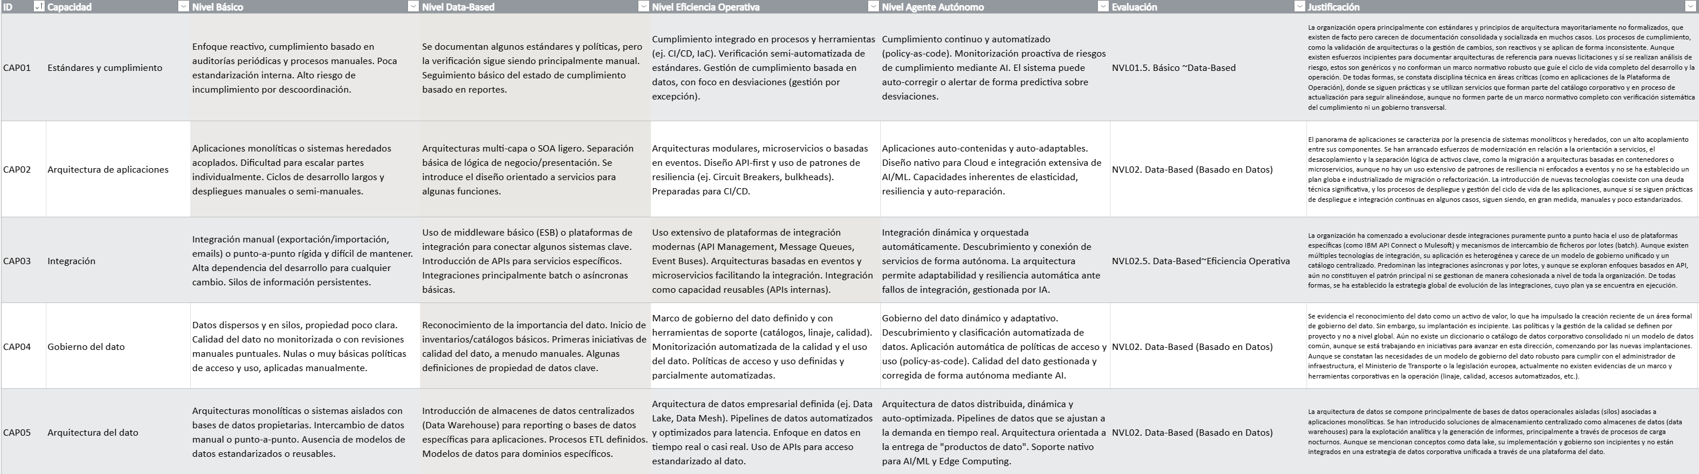
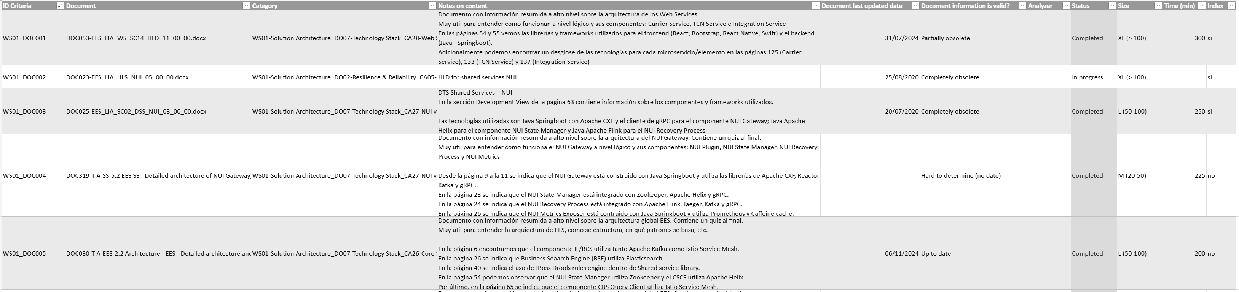
Phase 2 - Information & Documentation Discovery
A Phased Execution Methodology
DELIVERABLES - ILLUSTRATIVE EXAMPLES
D2.1. Evidence Collection Tracker
D2.2. Completed Assessment Questionnaires
Live tracker showing requested, received, pending and validated evidence across stakeholders, systems and suppliers.
Consolidated responses from relevant stakeholders, structured by assessment domain, dimension and criterion.

Slide 26
Phase 3 - Sovereignty Maturity Report Generation
A Phased Execution Methodology
Goal
Translate assessment insights into a clear management view of IAG’s most material sovereignty risks, enabling informed decisions on which exposures to mitigate, how urgently, and through which practical actions.
Activities
Duration
6 weeks
IAG Implication
Medium
Scoring and maturity assessment
  Apply the agreed scoring methodology consistently across the selected assessment scope.
  Score each relevant assessment criterion based on evidence, interviews and stakeholder validation.
  Document the rationale behind each score, including evidence references, assumptions and limitations.
  Identify areas of strength, partial compliance, control gaps and material exposure.
  Consolidate results at system, supplier, OpCo and domain level.
Consolidation of assessment outcomes
  Consolidate assessment outcomes into a sovereignty baseline view.
  Produce heatmaps by domain, dimension, system, supplier and OpCo, where applicable.
  Identify recurring patterns, systemic gaps and high-risk concentration areas.
  Distinguish between localized issues and enterprise-wide sovereignty concerns.
  Develop final executive report with findings, observations and hypotheses for an integrated view of IAG’s sovereignty posture.
Accelerators & Mechanisms
Assessment scoring rubric
Heatmap visualization model
Findings validation workshops
Prioritization matrix and Quick-Wins identification logics
Executive Summary Templates
Deliverables
D3.1. Sovereignty Maturity Report
D3.2. Main Findings Executive Summary
IAG Resources
Executive Sponsor / Project Lead
Enterprise Architects
System Owners

Slide 27
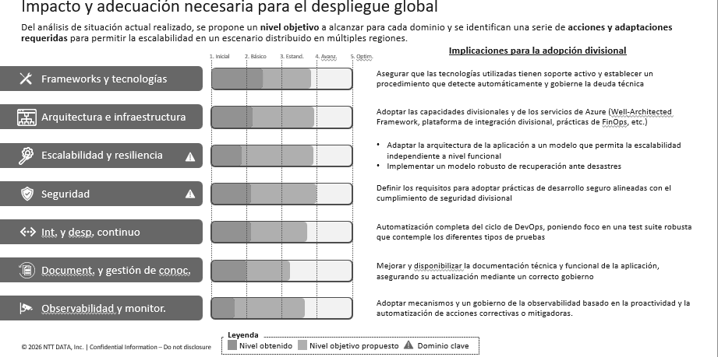
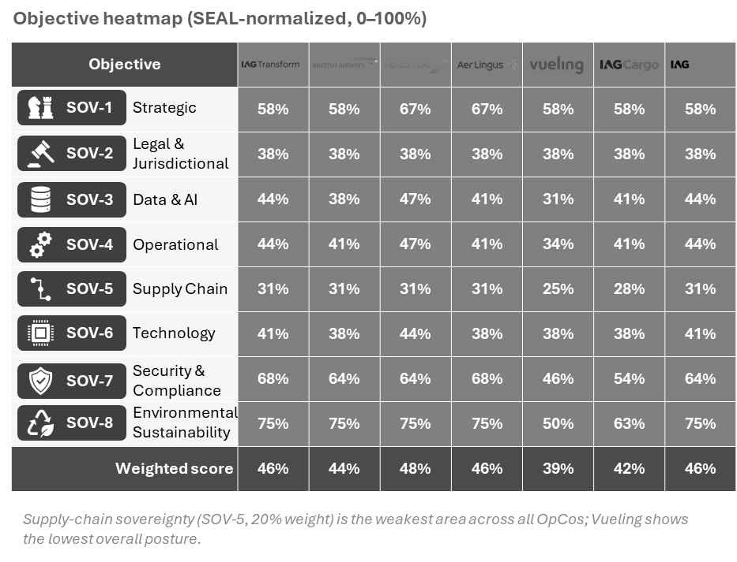
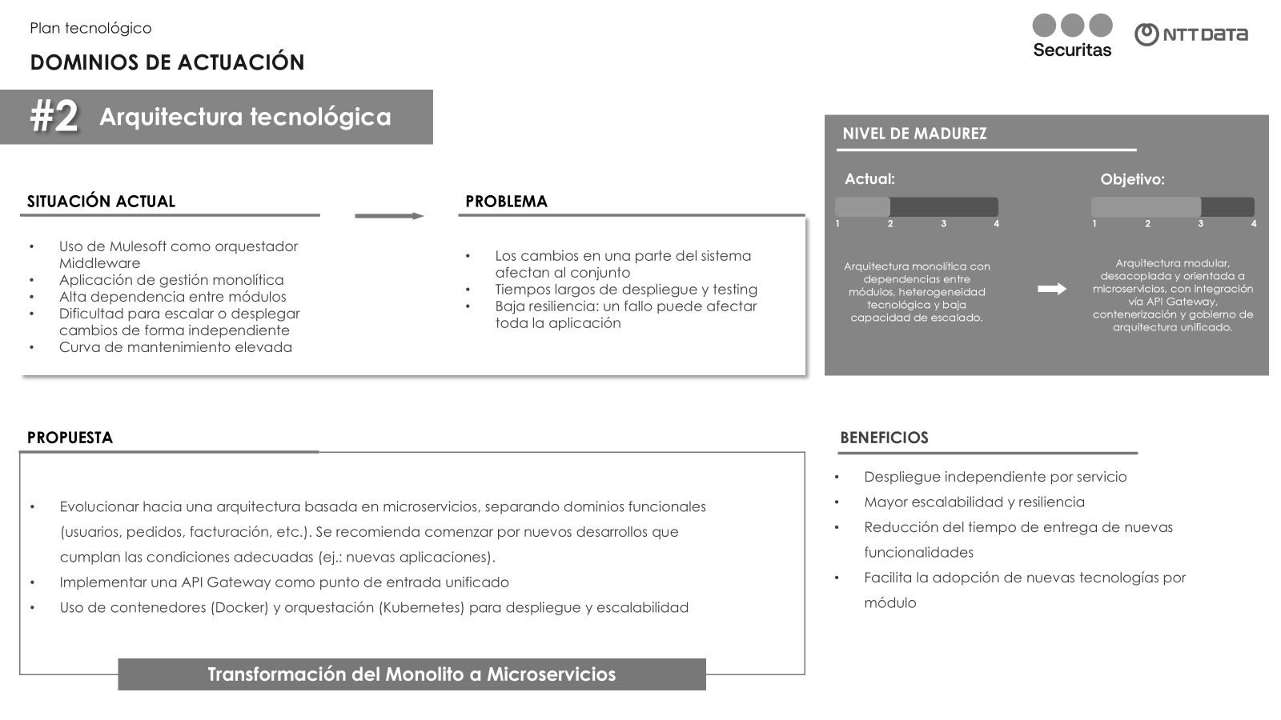
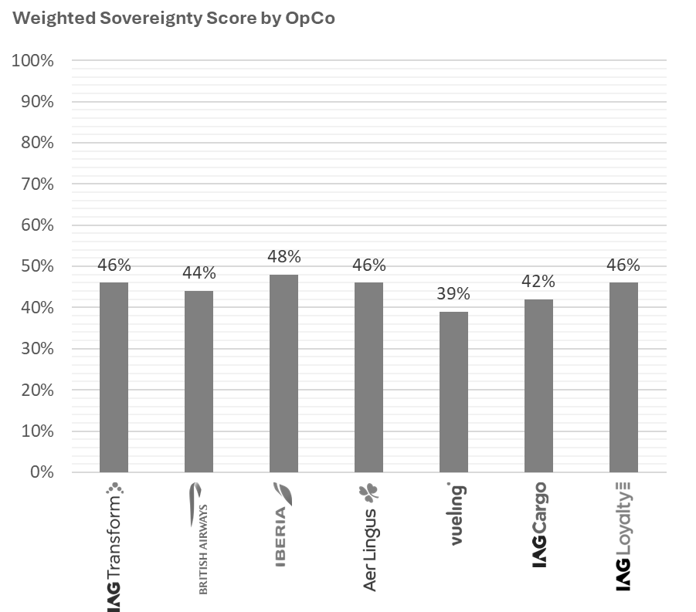
Phase 3 - Sovereignty Maturity Report Generation
Objective heatmap (SEAL-normalized, 0–100%)
Objective
 | 58% | 58% | 67% | 67% | 58% | 58% | 58%
 | 38% | 38% | 38% | 38% | 38% | 38% | 38%
 | 44% | 38% | 47% | 41% | 31% | 41% | 44%
 | 44% | 41% | 47% | 41% | 34% | 41% | 44%
 | 31% | 31% | 31% | 31% | 25% | 28% | 31%
 | 41% | 38% | 44% | 38% | 38% | 38% | 41%
 | 68% | 64% | 64% | 68% | 46% | 54% | 64%
 | 75% | 75% | 75% | 75% | 50% | 63% | 75%
Weighted score | 46% | 44% | 48% | 46% | 39% | 42% | 46%
SOV-1
Strategic
SOV-2
Legal & Jurisdictional
SOV-3
Data & AI
SOV-4
Operational
A Phased Execution Methodology
SOV-5
Supply Chain
SOV-6
Technology
SOV-7
Security & Compliance
DELIVERABLES - ILLUSTRATIVE EXAMPLES
SOV-8
Environmental
Sustainability
D3.1. Sovereignty Maturity Report
Supply-chain sovereignty (SOV-5, 20% weight) is the weakest area across all OpCos; Vueling shows the lowest overall posture.
As Is view of IAG’s current sovereignty posture across the agreed assessment scope, including strengths, weaknesses and key exposures:
Weighted Sovereignty Score by OpCo
Evidence-based SEAL rating of every criterion for each OpCo, with rationale and evidence.
Visual representation of assessment results by domain, dimension, system, supplier and/or OpCo to highlight risk concentration areas.
Structured list of validated findings, including description, affected scope, evidence, assessment score, impacted domain and initial risk implication.
Mapping of critical technology, supplier, jurisdictional, operational and data dependencies identified during the assessment.

Slide 28
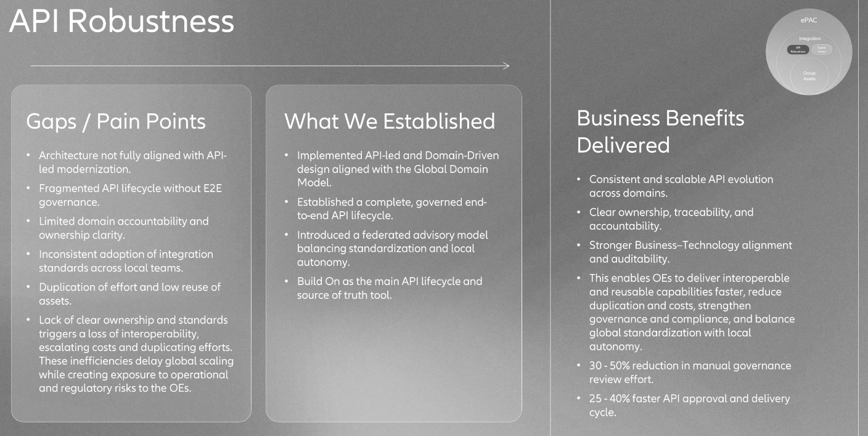
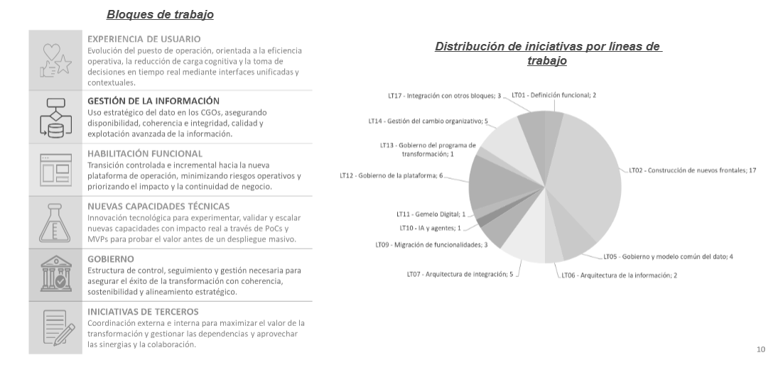
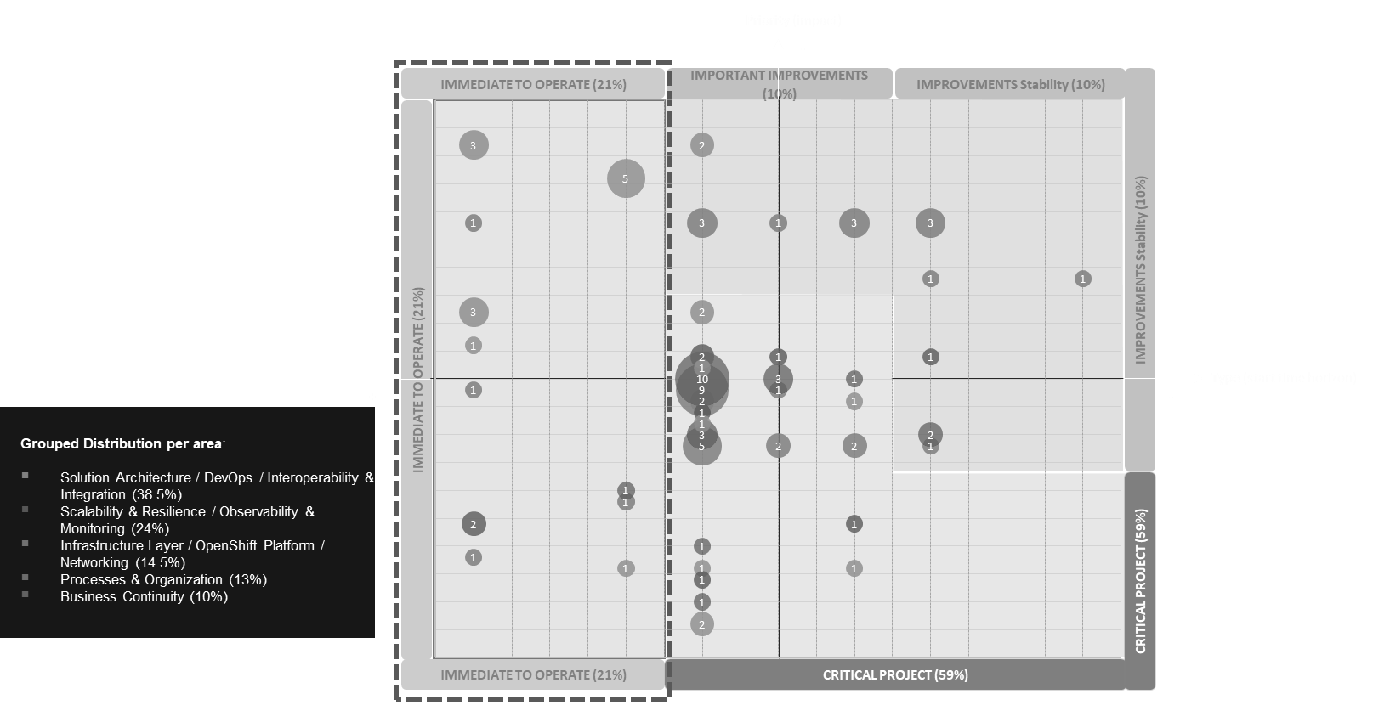
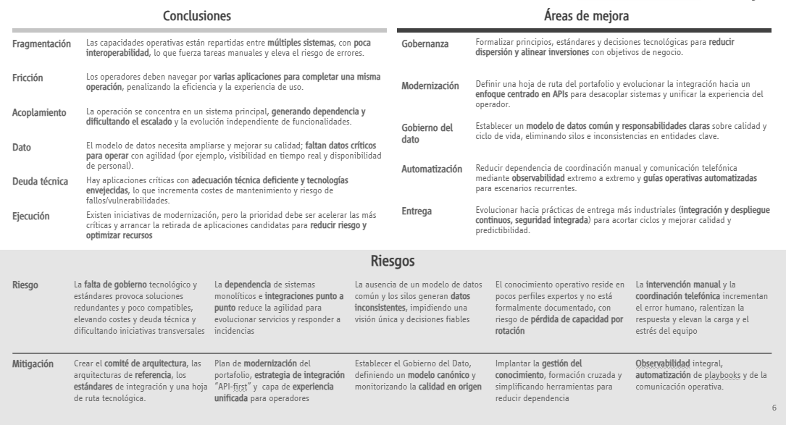
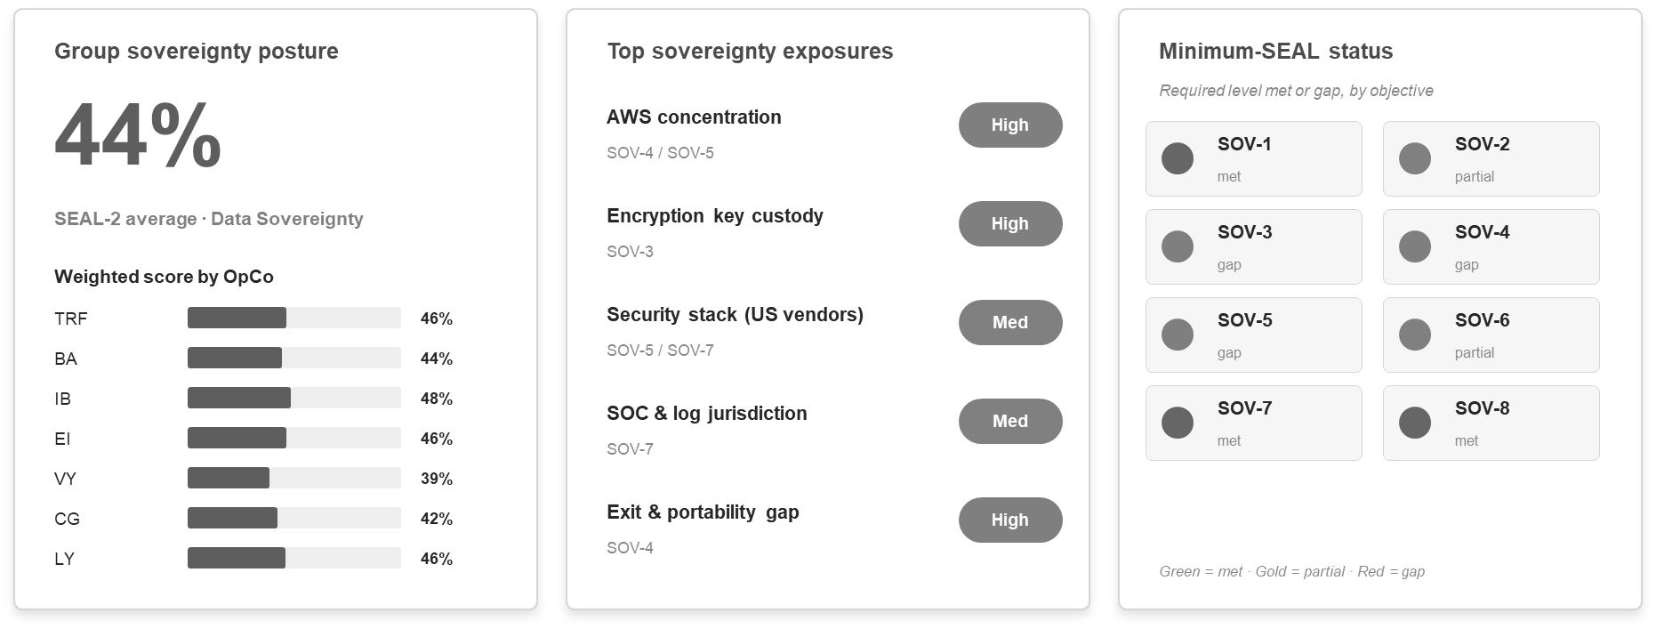
Phase 3 - Sovereignty Maturity Report Generation
A Phased Execution Methodology
Priority (impact)
DELIVERABLES - ILLUSTRATIVE EXAMPLES
-
IMMEDIATE TO OPERATE (21%)
IMPORTANT IMPROVEMENTS (10%)
IMPROVEMENTS Stability (10%)
D3.2. Main Findings Executive Summary
IMPROVEMENTS Stability (10%)
IMMEDIATE TO OPERATE (21%)
Type (start time horizon)
+
-
Grouped Distribution per area:
Solution Architecture / DevOps / Interoperability & Integration (38.5%)
Scalability & Resilience / Observability & Monitoring (24%)
Infrastructure Layer / OpenShift Platform / Networking (14.5%)
Processes & Organization (13%)
Business Continuity (10%)
CRITICAL PROJECT (59%)
Executive-level presentation summarizing conclusions as a synthesis of IAG’s current IT sovereignty posture, including strengths, key exposures and systemic concerns.
IMMEDIATE TO OPERATE (21%)
CRITICAL PROJECT (59%)
28

Slide 29

AI will be used as a controlled accelerator across the assessment lifecycle: supporting evidence classification, pattern detection, traceability, scoring preparation and consolidation of findings. All conclusions, SEAL ratings and recommendations remain under NTT DATA expert review and IAG stakeholder validation.
AI-assisted IT Sovereignty Assessment
How AI Supports the Execution
Maps available sources and evidence gaps
Clusters applications, suppliers and contracts by relevance
Supports prioritization of the assessment inventory
Aligns evidence needs with the SEAL FW
Classifies contracts, technical documents and supplier evidence
Extracts key clauses and technical indicators
Highlights dependencies, exposure patterns and inconsistencies
Prepares scoring inputs and validation packs
Consolidates validated findings across the assessment scope
Checks consistency between evidence, scores and conclusions
Summariness open assumptions and evidence limitations
AI-Enabled Output
Structured source map, evidence gap list, prioritized inventory support and tailored assessment materials.
Normalized evidence base, prioritized application scope analysis, dependency patterns, preliminary scoring inputs and validation packs.
Consolidated assessment outcomes, consistent findings narrative, evidence traceability summary and board-ready input pack.
Human-in-the-loop principles
No autonomous judgement
Evidence traceability
Expert validation
IAG-controlled usage
Every binding decision is validated and approved by a person.
Auditable traces and
decision records in place.
All relevant facts and insights are always reviewed by an expert domain lead.
Guaranteed full transparency
to participating IAG teams.

Slide 30
Project Plan & Delivery Team
04
A high-level roadmap along with the expert team to be involved during the next 3 months.

Slide 31
The project plan* has been structured in 3 main phases, designed to obtain a board-ready IT Sovereignty report after three months of work (by end of September).
Tentative High-Level Roadmap
 | JULY |  |  |  |  | AUGUST |  |  |  | SEPTEMBER
 | 29/06 ~03/07 | 06/07 ~10/07 | 13/07 ~17/07 | 20/07 ~24/07 | 27/07 ~31/07 | 03/08 ~07/08 | 10/08 ~14/08 | 17/08 ~21/08 | 24/08 ~28/08 | 31/08 ~04/09 | 07/09 ~11/09 | 14/09 ~18/09 | 21/09 ~25/09 | 28/09 ~02/10
Phase 1 - Systems Scope & Risk Clustering
Scope definition and prioritization
Stakeholder alignement
Assessment model tailoring and preparation
Phase 2 - Information & Documentation Discovery
Evidence collection and document review
Stakeholder interviews and workshops
Phase 3 - Sovereignty Maturity Report Generation
Scoring and maturity assessment
Consolidation of assessment outcomes
D1.1. Scope, Dependency and Risk Matrix
D1.2. Stakeholder Engagement and Access Plan
D1.3. Prioritized Assessment Inventory +
D1.4. Tailored IT Sovereignty Assessment Model
D2.1. Evidence Collection Tracker
D2.2. Completed Assessment Questionnaires
Executive Board Session
D3.1. Sovereignty Maturity Report
D3.2. Main Findings Executive Summary
*Delivery of this plan is subject to the commitment and availability of IAG teams to provide the required information on their systems, share relevant contractual documentation, and participate in the discovery sessions.

Slide 32



A group of multidisciplinary profiles with extensive technical expertise have been selected to lead the evaluation of each of the critical domains of the assessment:
Proposed Delivery Team
Core Team
Role | Function
Director / Manager | Ensures the strategic alignment of the project with IAG's management board, facilitating decision-making and coordination between teams.
Technical Project Leader | Leads the technical execution of the project and coordinates all the profiles, resolving possible risks, dependencies and blockages to guarantee the quality of each phase by complying with the scope and deadlines stipulated.
Domain Leaders | Responsible profiles for the evaluation approach of each of the assessment domains (also including a cross profile for Legal), coordinating the discovery and maturity scoring assigned.
Domain Analysts | Specialized team in charge of analyzing the documentation received and carrying out the information gathering workshops during Phase 2 of the project.
Partner / Director (Sponsorship)
Client Manager / Senior Manager
Technical Project Leader
Domain Specialist Teams
Legal
Advisory*
ExpertLead
INFRASTRUCTURE
STRATEGIC & ENVIRONMENTAL
OPERATIONS & TECHNOLOGY
DATA
SECURITY & COMPLIANCE
Analyst
*Legal advisory is excluded from the base scope and may be added as an optional workstream for detailed contract and jurisdictional review if required.

Slide 33
Economic Proposal
05
The required investment, based on the proposed methodology and activities for the assessment.

Slide 34
The proposed investment covers the full assessment across the agreed scope, including framework tailoring, evidence collection, sovereignty scoring, dependency analysis and board-level recommendations.
Investment & Commercial Considerations
Concept | Amount
IT Sovereignty Assessment Fee (3-months) | 199.633 €
Considerations:
This proposal shall remain valid for 30 business days from the date of submission.
The fees proposed by NTT DATA are provided on a fixed-price basis. The amounts indicated are exclusive of VAT, which shall be added as applicable.
The following material and technical means shall be made available to NTT DATA personnel for the delivery of the services:
  Access to all information and documentation from IAG required for the execution of the project.
  Remote access to the systems required to perform the agreed activities.
Travel-related expenses (including accommodation, meals and transportation) are not included within the scope of this proposal. Should such expenses be required, they will be submitted for prior approval and subsequently invoiced by NTT DATA upon appropriate justification.
Service invoicing shall be carried out as follows:
  50% of the total project fee upon project initiation.
  The remaining 50% upon completion of the project.
Payment terms shall be 60 days from the invoice date.

Slide 35
Commercial terms, delivery assumptions and client dependencies supporting the proposed assessment plan.
Investment & Commercial Considerations
Commercial Considerations:
The proposed delivery plan is dependent on the timely availability of IAG stakeholders, including application owners, platform teams, cybersecurity, data protection, procurement, supplier management and legal contacts.
IAG will provide complete, accurate and up-to-date information required for the assessment, including application inventories, architecture diagrams, data-flow maps, supplier documentation, contracts, DPAs, SLAs, cloud configuration evidence and relevant security/control documentation.
Evidence, clarifications and stakeholder feedback should be provided within the agreed response times. Delays, incomplete documentation or limited access may impact the assessment depth, prioritization accuracy and/or delivery timeline.
IAG will facilitate the required access to repositories, documentation sources, systems and collaboration tools, subject to IAG’s internal security, confidentiality and data protection policies.
Assessment conclusions, SEAL ratings and recommendations will be evidence-based, relying on the information made available, stakeholder interviews and agreed assumptions, and will be validated with IAG before final reporting.
NTT DATA may use secure, private and controlled AI capabilities as an assessment accelerator, supporting evidence classification, pattern detection, traceability and scoring preparation. AI will not make autonomous decisions; all outputs will remain subject to NTT DATA expert review and IAG validation.
The scope is limited to the agreed IT Sovereignty baseline assessment for the selected applications, suppliers, platforms, contracts and data domains. Additional systems, deeper supplier reviews, remediation design or implementation activities would require separate agreement.
Legal and regulatory aspects will be assessed from an IT sovereignty risk perspective. Formal legal advice, legal opinions or detailed contractual negotiation support are excluded unless agreed as a dedicated workstream.
The assessment is a diagnostic and prioritization exercise, and does not constitute a regulatory certification, external audit opinion or formal compliance attestation.
Any material change in scope, assumptions, stakeholder availability, access constraints or required analysis depth may require replanning and, where applicable, commercial reassessment.

